Slide 1


Utter Confusion
By Shane Farrell
Notes:
Hello my name is Shane Farrell
I made Utter Confusion and am going to present to you on it now

Slide 2

Who I Am
Student at DIT Computer Science
Making games for 10 years
Started in Junior School with Power Point
Notes:
Since I was 10 years old in fifth class
Story

Slide 3
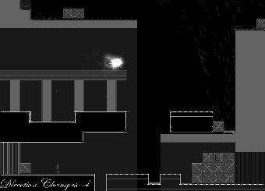
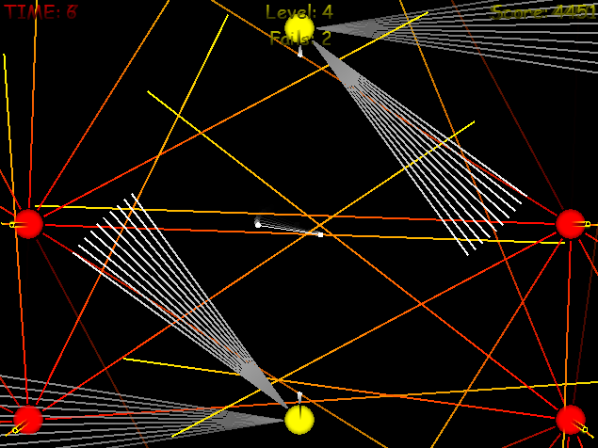
What I Like to Make
Simple games
Explore new concepts
Challenging
Benefit to player
Hitboxes
Notes:
Pick up and play
You can get away with a lot more if you always give the benefit of the doubt to the player
Make them feel more epic, like they have overcome more

Slide 4
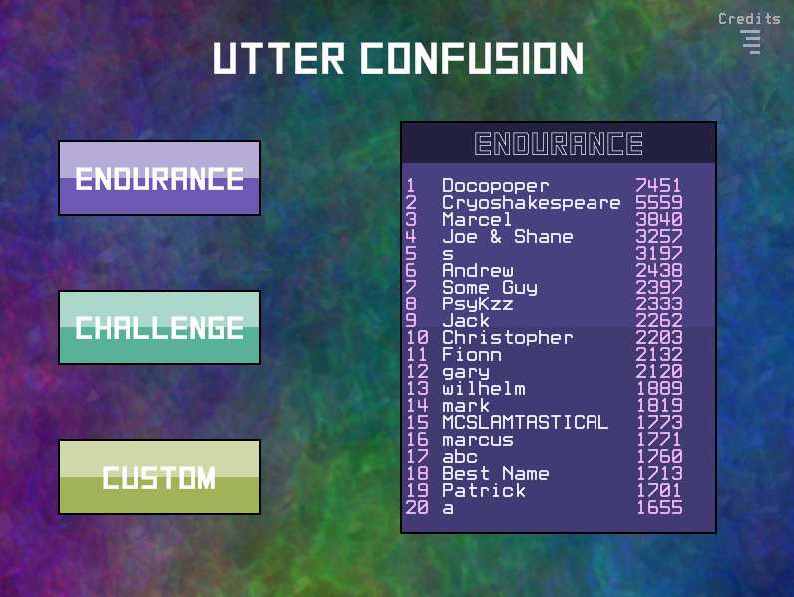
Notes:
And the game I’m making for this competition is Utter Confusion.
It’s actually a much more polished version of one of the first full games I ever made.
This is the fourth version I have made and I have refined the game play considerably.

Slide 5
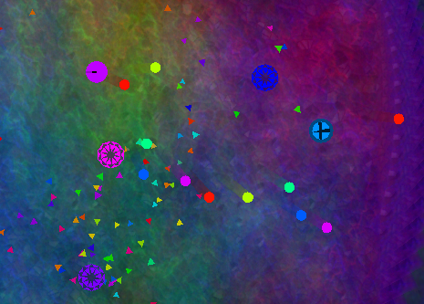
Utter Confusion
Spinning camera
High score
Collect confetti
Competitive
Notes:
The premise behind it is to be able to keep your cool for as long as possible while the game spins and zooms the camera and just generally tries to confuse you.
The game is high score based and its core engagement is in competing with your friends and watching them fail and laugh at them.
The game simply involves fighting off infinitely spawning enemies and collecting the confetti they drop.

Slide 6
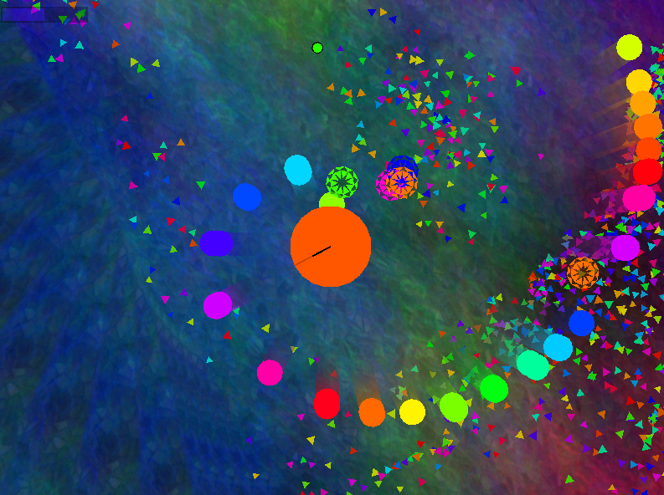
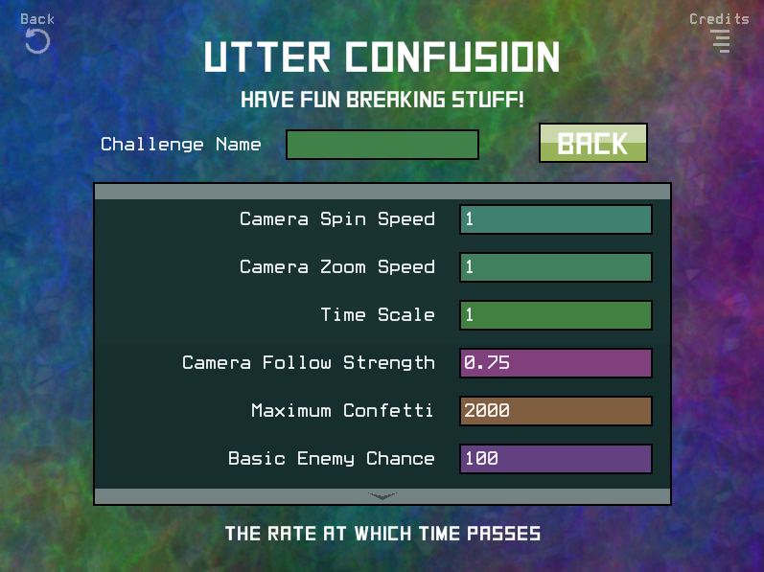
Utter Confusion
Highly customisable
Change any variable
Challenge mode
Notes:
To add replay value and give the player something to do when they don’t have friends near bye I have included challenges and the ability to make custom game modes that let you change almost ever variable in the game. Or at least the ones that you’d want to change.

Slide 7
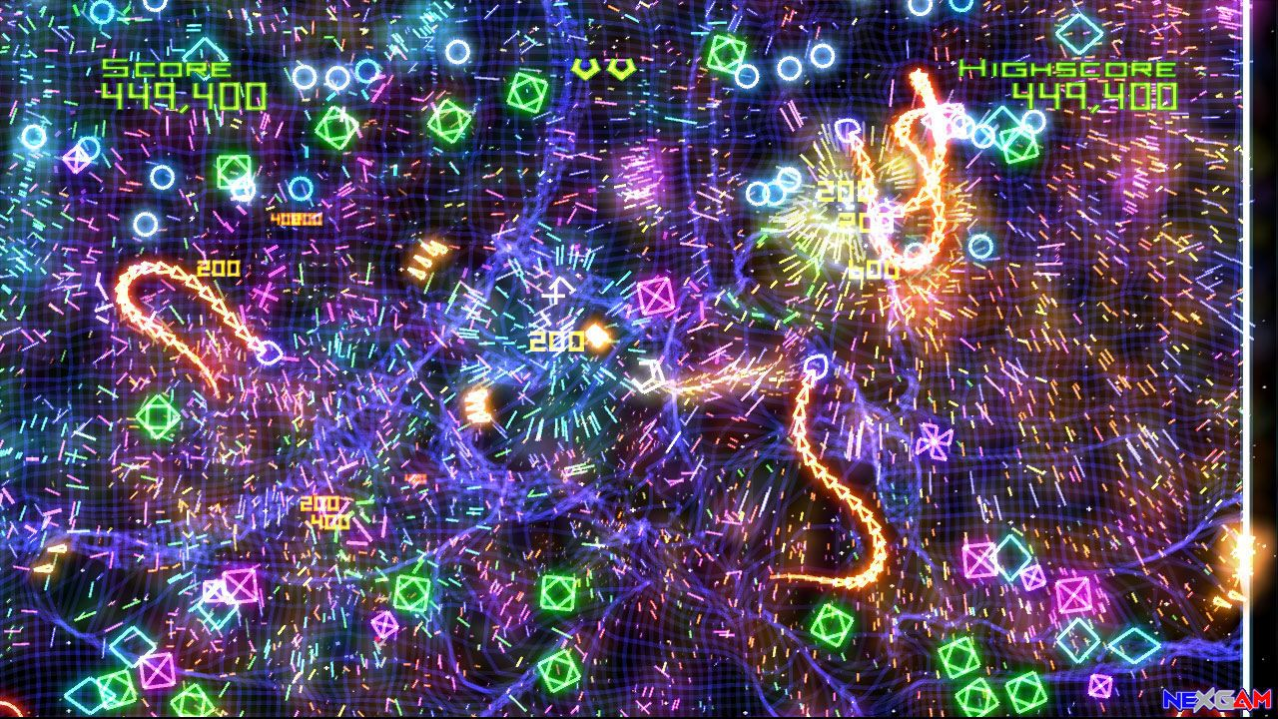
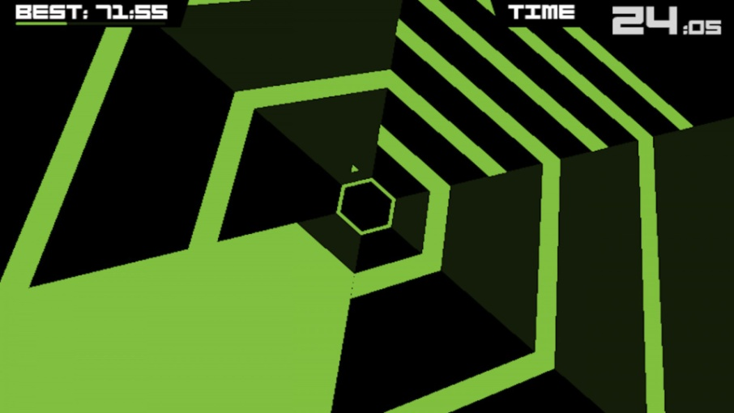
Target Audience
Simple challenging game
Super Hexagon, Geometry Wars
Notes:
The audience that I am aiming for with this game are the type that would play games like Geometry Wars and Super Hexagon.
The game is a simple challenge and is pretty easily accessible.

Slide 8

Marketing
Sell cheaply - €2
Get Let’s Plays
Half price coupon
Watch people fail
Notes:
Set up website. Feel encouraged to link for coupon. Feel like they’re helping their community. Helps them too.

